Slide 1
Training on AVR Microcontroller for Automation in Power Sector
Module: M#7
External Interrupts (continued)
Professor S.M. Lutful Kabir
IICT, BUET
March, 2018

Slide 2
Internal and External Interrupt Sources
The AVR 8-bits microcontroller provide both internal and external interrupt sources. The internal interrupts are associated with the microcontroller's peripherals.
They are the Timer/Counter, Analog Comparator, etc.
The external interrupts are triggered via external pins.
On AVR ATmega32 microcontroller there are four (4) external interrupts:
RESET Interrupt - Triggered from pin 9.
External Interrupt 0 (INT0) - Triggered from pin 16.
External Interrupt 1 (INT1) - Triggered from pin 17.
External Interrupt 2 (INT2) - Triggered from pin 3.

Slide 3
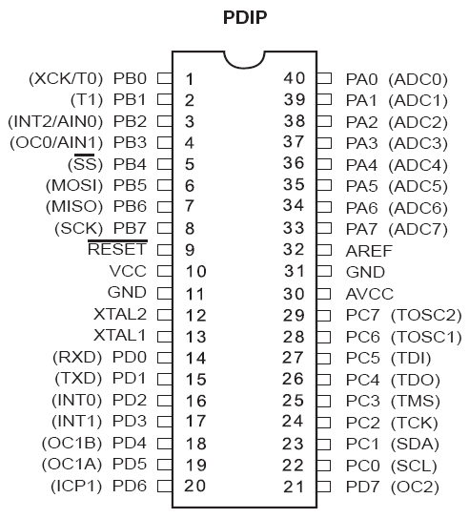
External Interrupt Pins

Slide 4
External Interrupts
The number of external hardware interrupts varies in different AVRs.
The ATmega32 has three external interrupts: pin PD2 (PORTD.2), PD3 (PORTD.3) and PB2 (PORTB.2), designated as INT0, INT1 and INT2 respectively.
Upon activation of these pins, the AVR is interrupted in whatever it is doing and jumps to the vector table to perform the interrupt service routine.

Slide 5
External Interrupts INT0, INT1 and INT2
The interrupt vector table locations $2, $4 and $6 are set aside for INT0, INT1 and INT2, respectively.
The hardware interrupts must be enabled before they can take effect.
This is done using INTx bit located in GICR (General Interrupt Control Register).
GICR Register
INT1 | INT0 | INT2 | - | - | - | IVSEL | IVCE

Slide 6
Interrupt Sense Control bits for INT0
MCUCR (MCU Control Register)
SE | SM1 | SM2 | SM0 | ISC11 | ISC10 | ISC01 | ISC00
ISC01 and ISC00 - These bits define the level or edge on the external INT0 pin that activates the interrupts, as shown in the following table
ISC01 | ISC00 |  | Description
0 | 0 |  | The low level of INT0 generates an interrupt request
0 | 1 |  | Change on INT0 generates an interrupt request
1 | 0 |  | Falling edge of INT0 generates an interrupt request
1 | 1 |  | Rising edge of INT0 generates an interrupt request

Slide 7
Interrupt Sense Control bits for INT1
MCUCR Register
SE | SM1 | SM2 | SM0 | ISC11 | ISC10 | ISC01 | ISC00
ISC11 and ISC10 - These bits define the level or edge on the external INT1 pin that activates the interrupts, as shown in the following table
ISC11 | ISC10 |  | Description
0 | 0 |  | The low level of INT1 generates an interrupt request
0 | 1 |  | Change on INT1 generates an interrupt request
1 | 0 |  | Falling edge of INT1 generates an interrupt request
1 | 1 |  | Rising edge of INT1 generates an interrupt request

Slide 8
Interrupt Sense Control bit for INT2
Interrupt 2 (INT2) can only be configures as edge triggered mode.
In other words it can not be configured as level triggered.
ISC2 bit of MCUCSR (MCU Control and Status Register) defines whether INT2 interrupt will activate on falling or rising edge.
MCUCSR Register
JTD | ISC2 | - | JTRF | WDRF | BORF | EXTRF | PORF
IS2 |  | Description
0 |  | Falling edge of INT2 generates an interrupt request
1 |  | Rising edge of INT2 generates an interrupt request

Slide 9
Sampling the edge-triggered and level-triggered interrupts
The edge-interrupt (the falling edge, the rising edge or the change level) is latched by the AVR.
It is latched by the INTFx bits of GIFR (General Interrupt Flag Register).
This means that when an external interrupt is in an edge-triggered mode (falling edge, rising edge or level change), upon triggering an interrupt request, the related INTFx flag becomes set.
GIFR Register
INTF1 | INTF0 | INTF2 | - | - | - | - | -

Slide 10
Monitoring An Event by Polling
Two push button switches are connected in INT0 (PD.2) [Push1] and INT1 (PD.3) [push2]pins of your microcontroller ATmega32.
8 (eight) LEDs are connected in Port C.
An LCD is connected in Port A.
Since PD.2 and PD.3 are interrupt pins so whenever switches are pushed External Flag (INTF0 and INTF1 bits of GIFR register respectively) will be raised.

Slide 11
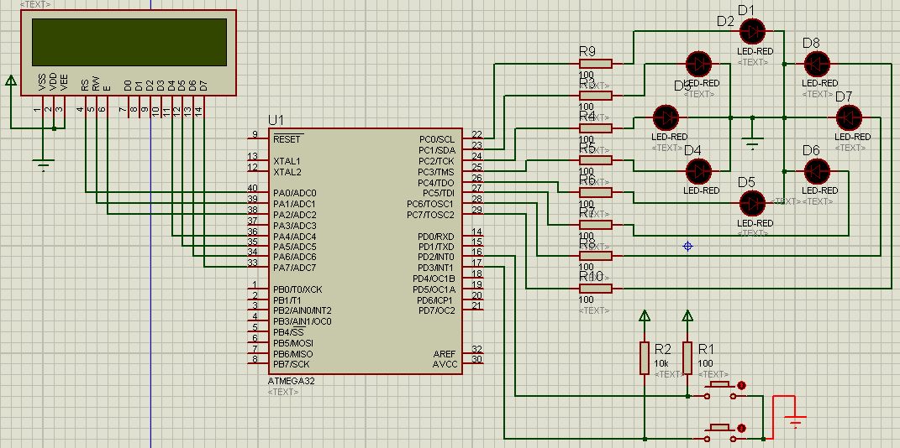
Simulation Diagram

Slide 12
The Code for Interrupt Method
#include <mega32.h>
#include <alcd.h>
#include <stdlib.h>
#define output_ddr DDRC
#define output_port PORTC
char disp[16], move=0;
unsigned int i=0, k=0;
void display_lcd(void)
{
lcd_gotoxy(0,0);
itoa(i,disp);
lcd_puts(disp);
lcd_gotoxy(0,1);
itoa(k,disp);
lcd_puts(disp);
}
interrupt [EXT_INT0] void ext_int0_isr(void) {
move=1;
lcd_clear();
display_lcd(); }
interrupt [EXT_INT1] void ext_int1_isr(void) {
move=2;
lcd_clear();
display_lcd(); }
void main(void)
{
output_ddr=0xFF;
output_port=0x80;
GICR|=(1<<INT1) | (1<<INT0) | (0<<INT2);
MCUCR=(1<<ISC11) | (0<<ISC10) | (1<<ISC01) | (0<<ISC00);
#asm("sei")
lcd_init();
while (1)
{
if (move==1)
{
output_port=output_port>>1;
if (output_port==0)
output_port=0x80;
}
if (move==2)
{
output_port=output_port<<1;
if (output_port==0)
output_port=0x01;
}
for (i=0; i<100; i++)
{
for (k=0; k<3000; k++)
{
// looping to create a delay
}
}
}
}

Slide 13
Interrupt within an Interrupt
When AVR is executing an ISR corresponding to an interrupt, what happens if another interrupt is activated?
In fact, when the AVR begins to execute an ISR, microcontroller, on its own, disables the ‘I’ bit of the SREG register.
So, no other interrupts occur while serving that ISR.
When ISR is finished, the microcontroller again, on its own, enables the ‘I’ bit, causing other interrupts to be served.

Slide 14
Interrupt within an Interrupt…..
If you want another interrupt (with any priority) to be served while the current interrupt is being served you can set the ‘I’ bit using SEI instruction.
But do it with care.
For example, in a low level triggered external interrupt, enabling the ‘I’ bit while the pin is still active will cause the ISR to be reentered infinitely, causing unpredictable consequence.

Slide 15
Experiment Demonstrating Multiple Interrupts
Let us say we have two tasks to do.
Task #1 - to display 0-9 digits one by one in a 7-segment display with a delay of 1 sec.
Task #2 - to glow one LED within a group of eight LEDs. Only the leftmost LED will glow first. After one second, only its adjacent one and so on until it reaches to the right most one.
Task #1 will be executed with the interrupt Int0 and Task #2 with Int1.
In the main program both the 7-segment display and the LED group will be made OFF.

Slide 16
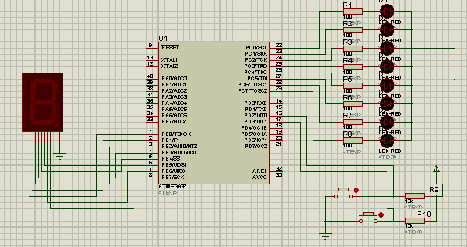
Design

Slide 17
Observation in the Experiment
1. What happens if we interrupt Int0 when Int1 is being executed and vice versa.
2. If you enable Global Interrupt Bit only in the ISR for Int0 what happens if you interrupt Int1 while ISR for Int0 is being served and vice versa.
3. Observe the outcome by enabling Global Interrupt Bit in ISR for Int1 only.
4. Observe the outcome by enabling Global Interrupt Bit in both the ISRs.

Slide 18
Header file and Variable declaration
#include <mega32.h>
#include <delay.h>
#define segment_ddr DDRB
#define segment_port PORTB
#define led_ddr DDRC
#define led_port PORTC
unsigned int cathode[10]={0x3F,0x06,0x5B,0x4F,0x66,0x6D,0x7D,0x07,0x7F,0x6F};
unsigned int i=0,k=0;

Slide 19
Main Program multi_int
void main(void)
{
segment_ddr=0xFF;
led_ddr=0xFF;
GICR=(1<<INT1) | (1<<INT0) | (0<<INT2);
MCUCR=(1<<ISC11) | (0<<ISC10) | (1<<ISC01) | (0<<ISC00);
#asm("sei")
while (1)
{
segment_port=0x00;
led_port=0x00;
}
}

Slide 20
ISR for Int0
// External Interrupt 0 service routine
interrupt [EXT_INT0] void ext_int0_isr(void)
{
// #asm("sei")
for (i=0;i<10;i++)
{
segment_port=cathode[i];
delay_ms(1000);
}
}

Slide 21
ISR for INT1
// External Interrupt 1 service routine
interrupt [EXT_INT1] void ext_int1_isr(void)
{
// #asm("sei")
led_port=0x80;
delay_ms(1000);
for (k=1;k<8;k++)
{
led_port=led_port>>1;
delay_ms(1000);
}
}

Slide 22
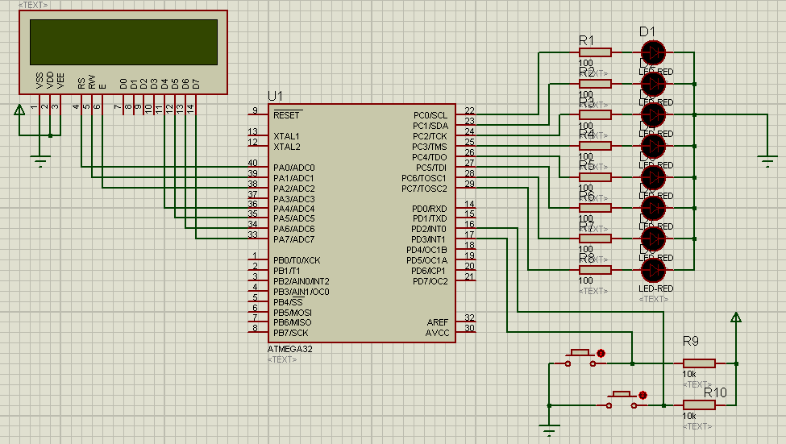
Lab Exercise

Slide 23
Thanks

